Slide 1
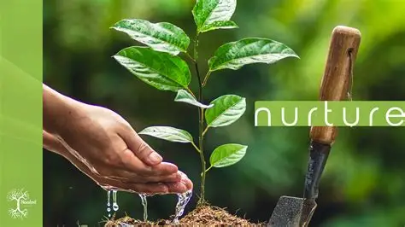

Slide 2
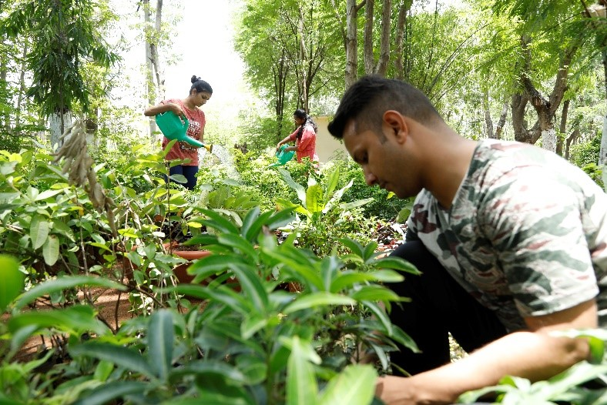
Where Nature is Nurtured
In a world where environmental damage is growing faster than awareness, Mission Prakriti restores balance — reconnecting people with the natural world. It’s built on the belief that protecting the planet is not a choice, but a shared responsibility for every generation

Slide 3
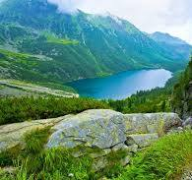
The natural environment includes everything that exists naturally on Earth—land, water, air, plants, animals, and ecosystems. It is the foundation of life and the key to a healthy planet. However, modern human activities are putting immense pressure on this delicate system. This article explains what the natural environment is, why it matters, what threatens it, and how we can protect it. With practical steps and global awareness, we can restore balance and secure a better future for all living

Slide 4
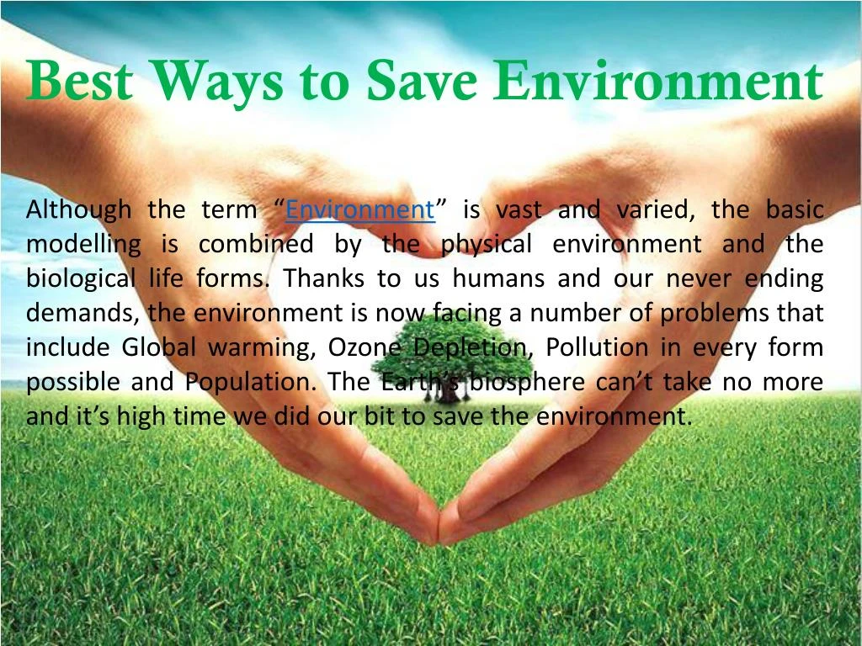

Slide 5
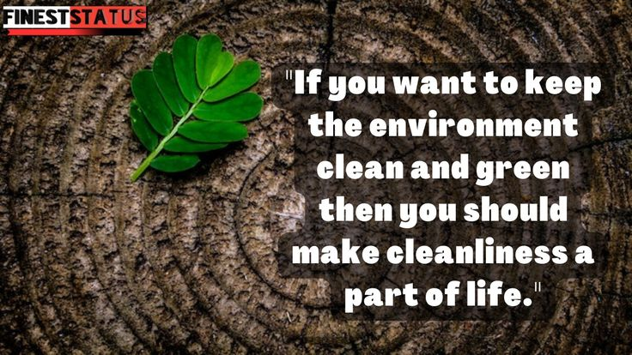

Slide 6
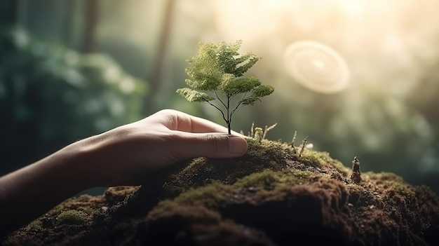
The air we breathe
The water in lakes, rivers, and oceans
The soil that supports life
The plants and animals that live across ecosystems
Unlike artificial environments made by humans (like cities and buildings), the natural environment is untouched or only slightly altered. It forms the life-supporting system for every organism on the earth or on our planet.

Slide 7
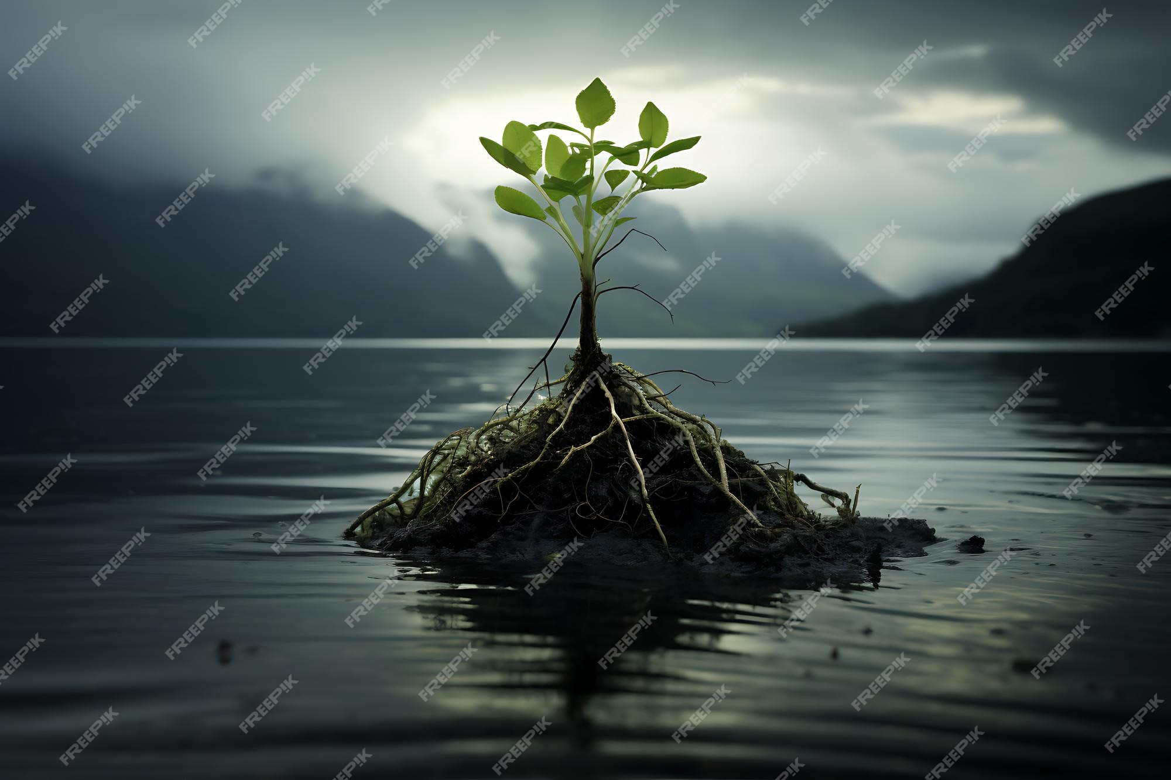

Slide 8
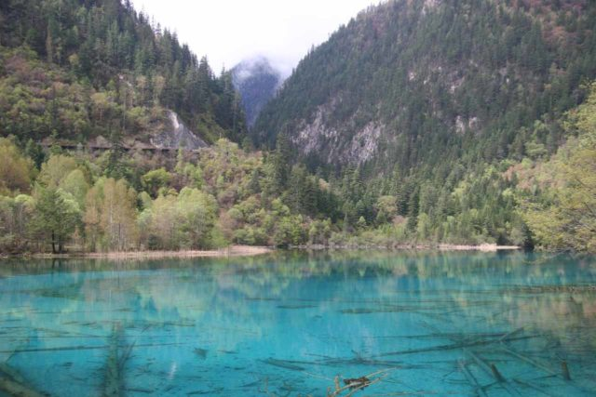

Slide 9
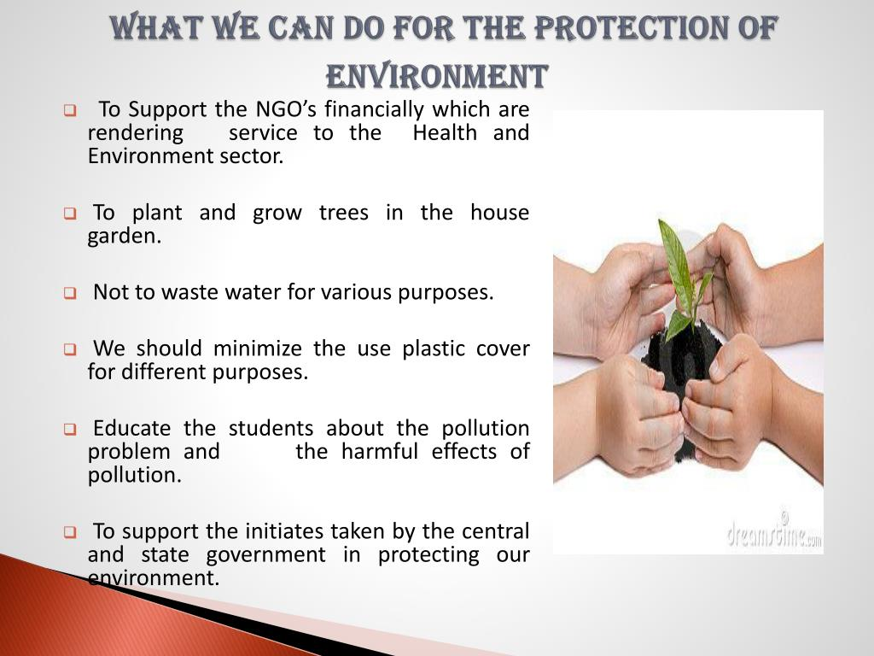

Slide 10
